Slide 1
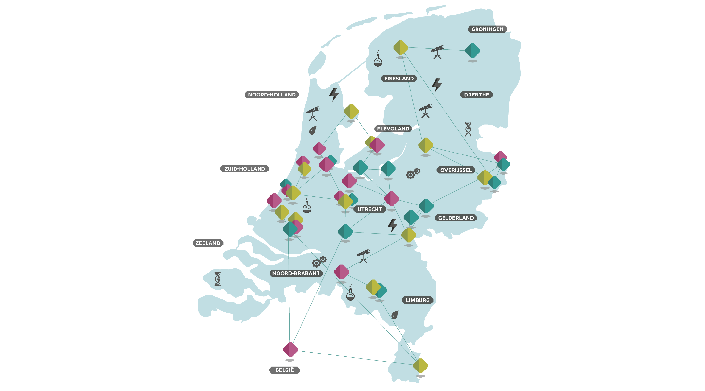

Slide 2
SCIENCE COMMUNICATION
FOR SOCIETAL IMPACT
-
OBSTACLES AND CRITERIA
Alex Verkade – Sep 15, 2020 @alexverkade

Slide 4
WHAT ARE YOUR FAVORITE
EXAMPLES OF
SCIENCE COMMUNICATION?
Please answer in chat

Slide 5
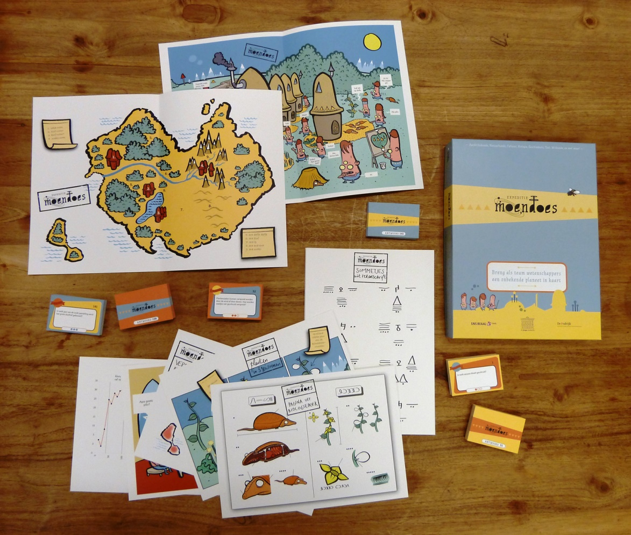
Notes:
DJA on Wheels
plus: game
story about space exploration/planet
simulation of science

Slide 6
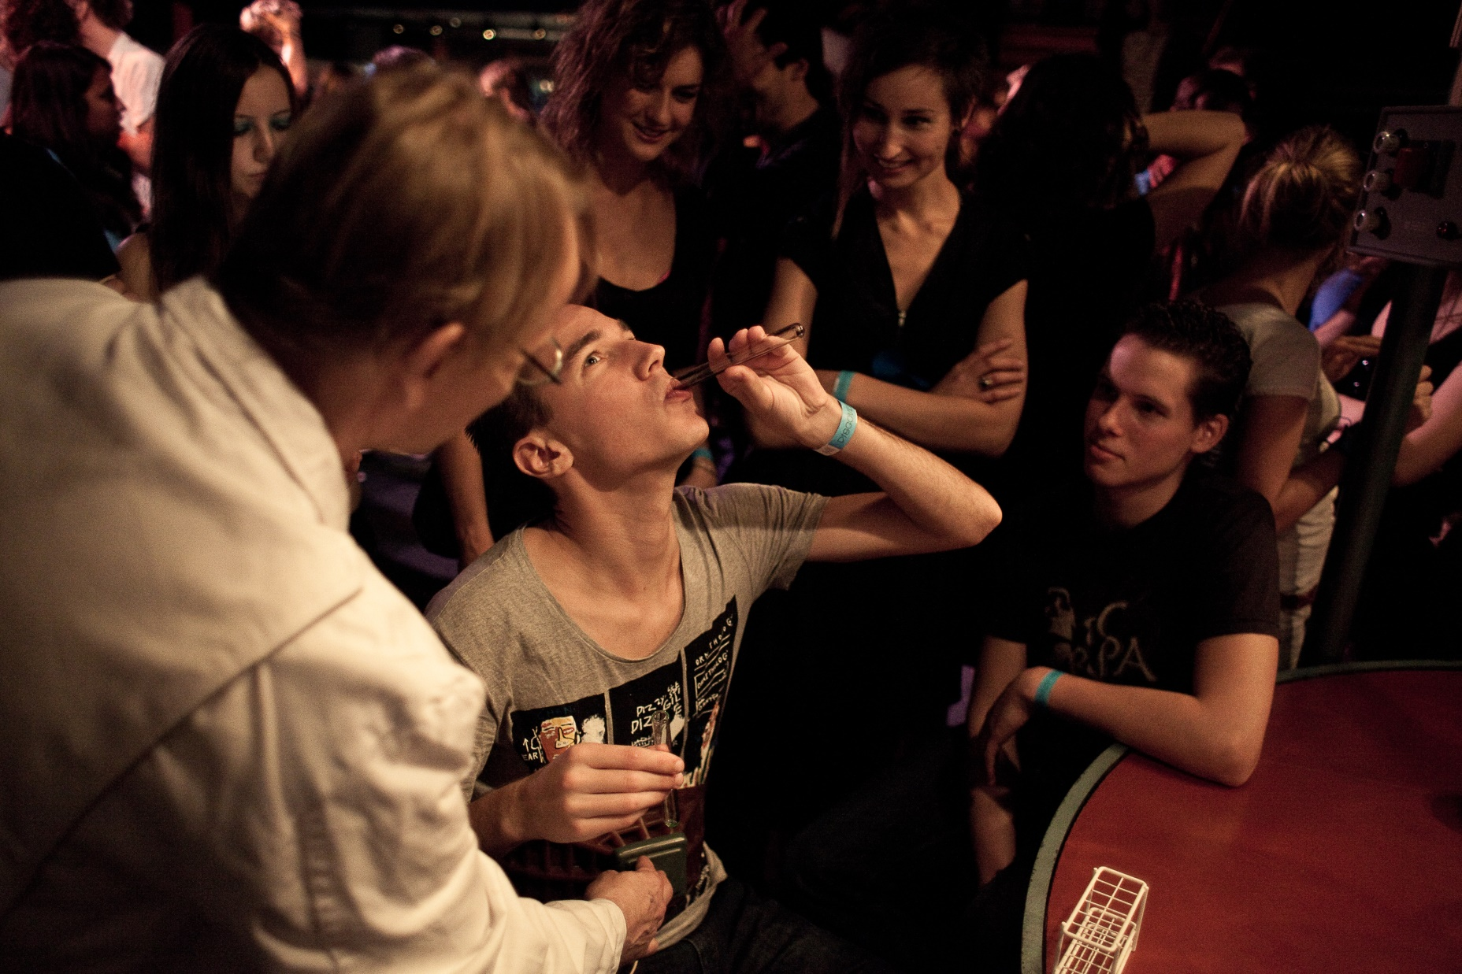
Notes:
uitleg wat dit was => cijfers. aantal bezoekers, goals and target group
wtsch prog bv: zoveel mogelijk experimenten (pijn) / demo’s, games (robot dating) / maar ook Occam’s Beard en 20PK
10 yrs; night; expo; schools; guest programming at other festivals

Slide 7
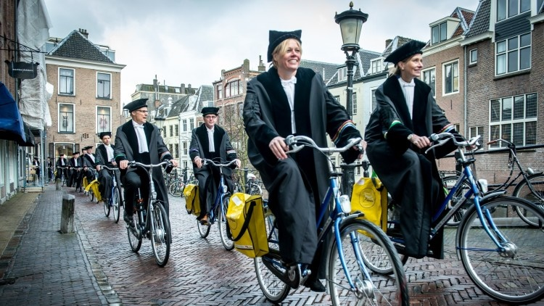

Slide 8
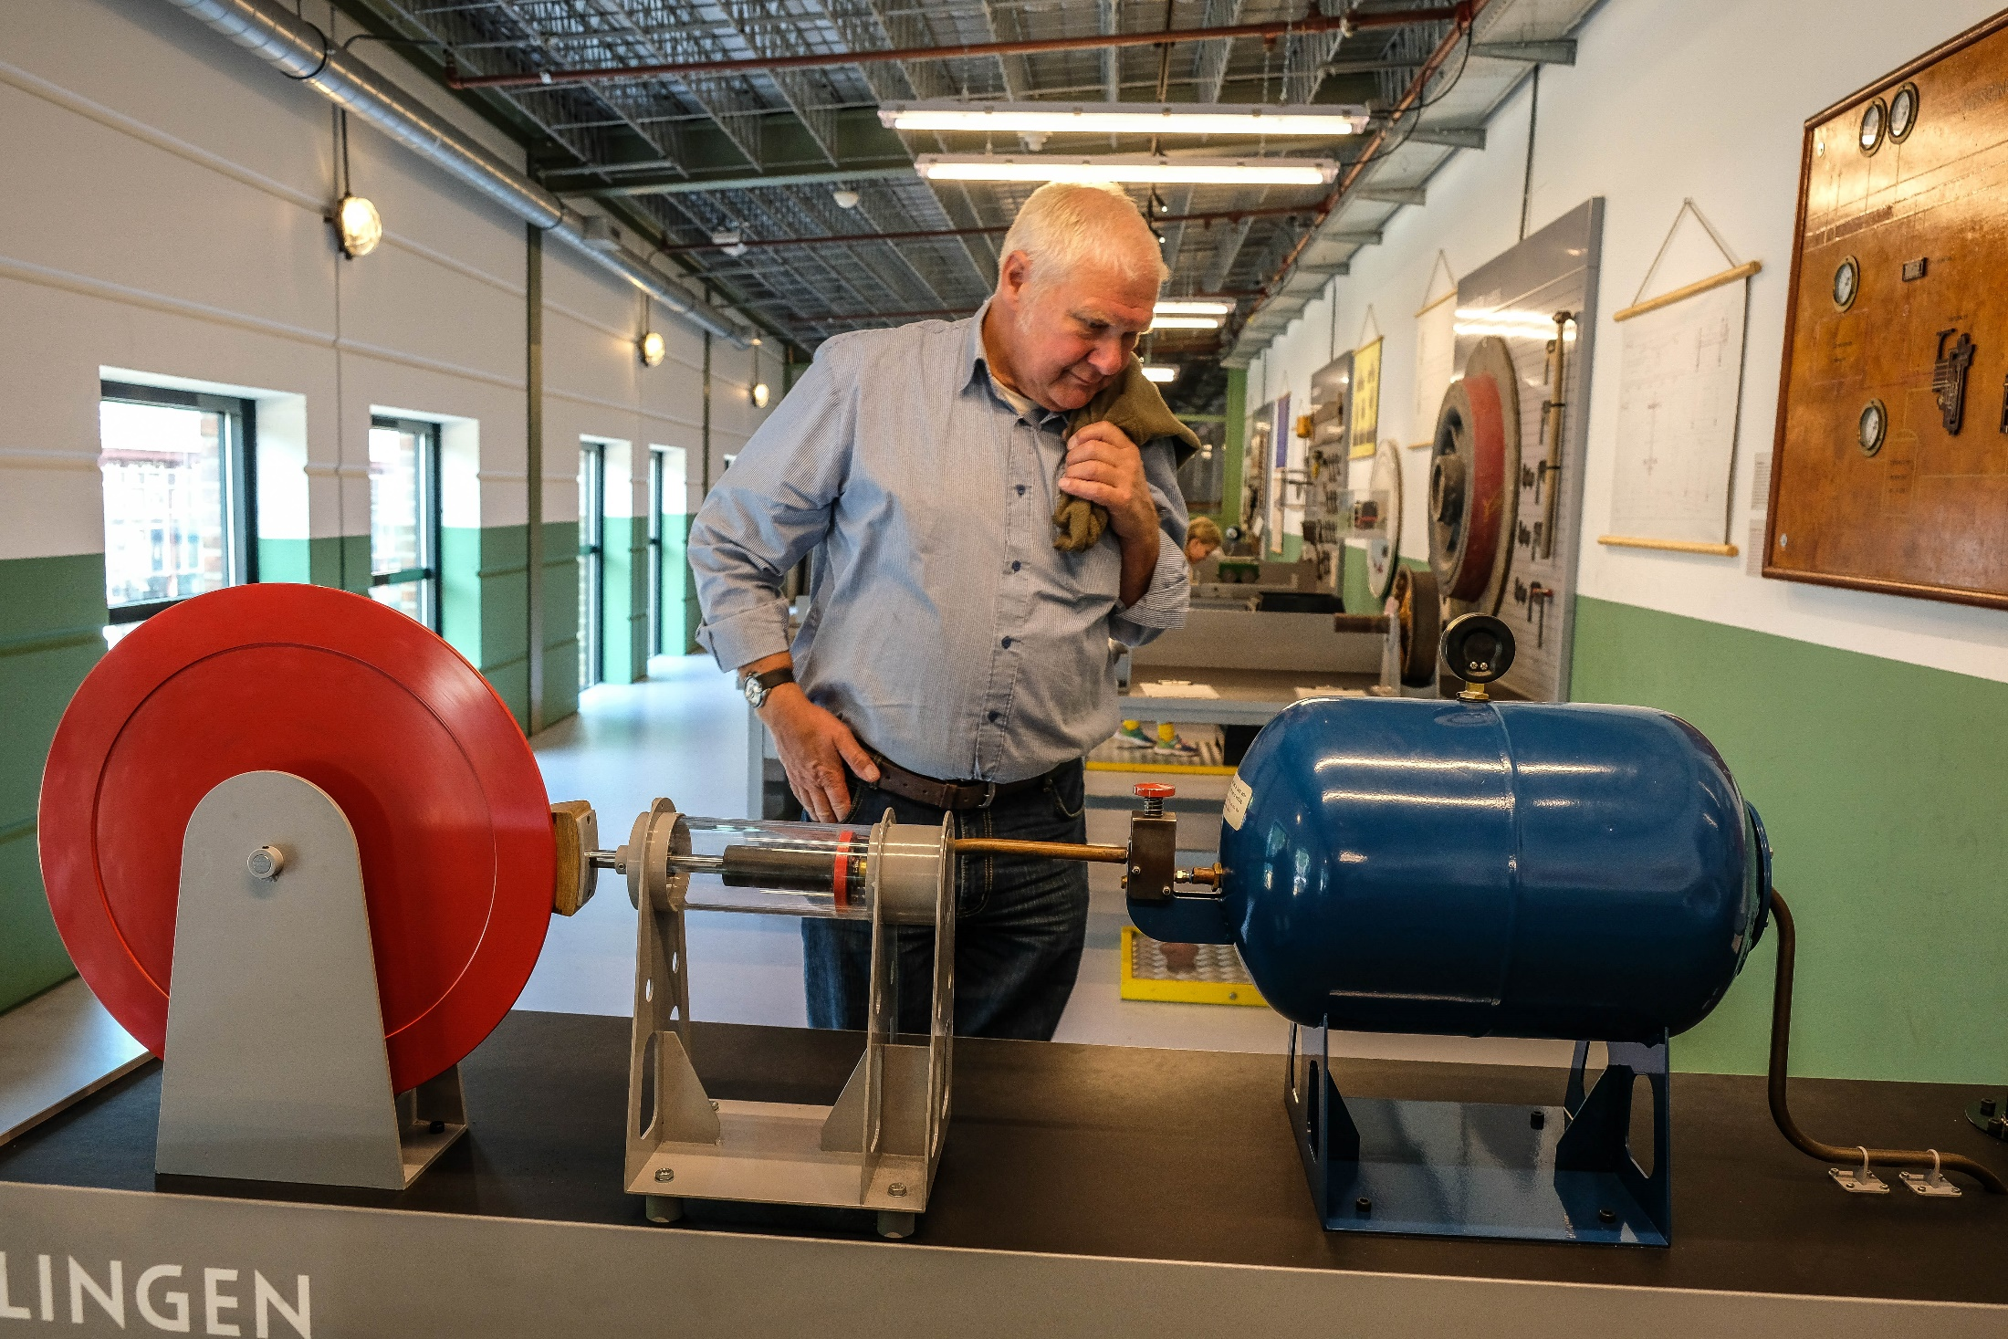

Slide 9
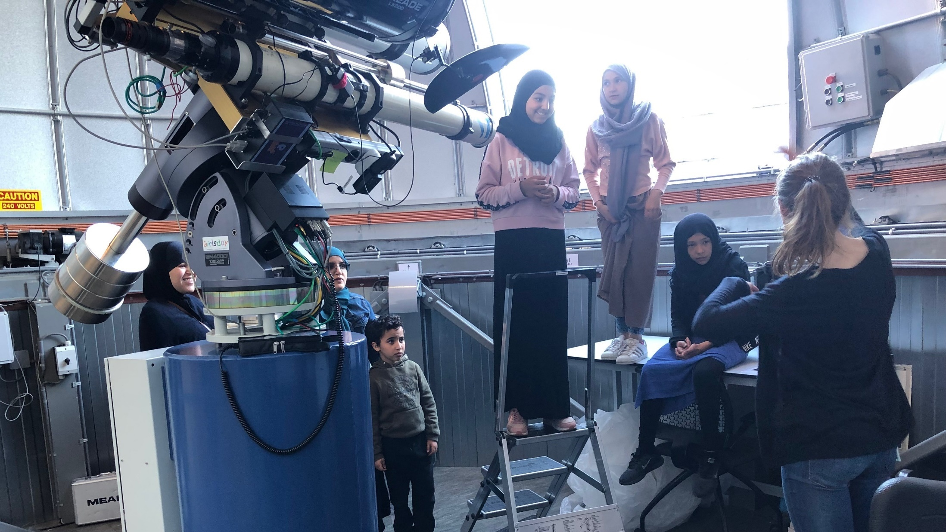

Slide 10
SOME MORE EXAMPLES
MOOC
science center exhibit
smartphone app with historic walk
citizen science project
childrens lectures
discussion events with citizens
city science festival
school project in lower SES neighborhood
TV interview
university museum
podcast series
serious game

Slide 11
Science communication (sci com):
the use of suitable communication skills, means and activities to stimulate and reward public engagement with science.

Slide 12
(ME
De Praktijk / 200+ sci com projects
Rathenau Institute / sci com policy research
VSC / community mgmt, advocacy
Amsterdam, 1 child, death metal
Notes:
a lot of edu materials and some event programming/organisation, but also games etc
RI project in very short

Slide 13
Notes:
DJA on Wheels
plus: game
story about space exploration/planet
simulation of science

Slide 14
Notes:
uitleg wat dit was => cijfers. aantal bezoekers, goals and target group
wtsch prog bv: zoveel mogelijk experimenten (pijn) / demo’s, games (robot dating) / maar ook Occam’s Beard en 20PK
10 yrs; night; expo; schools; guest programming at other festivals

Slide 16
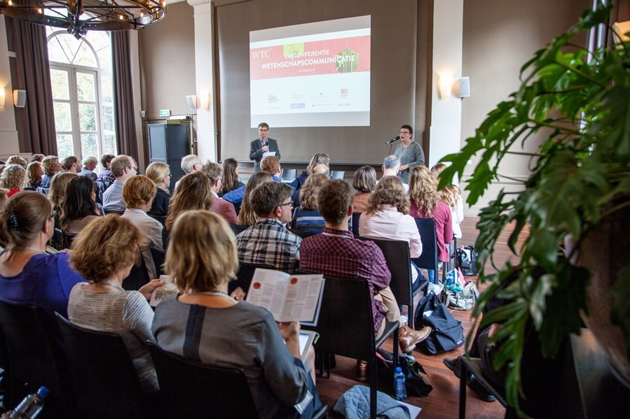
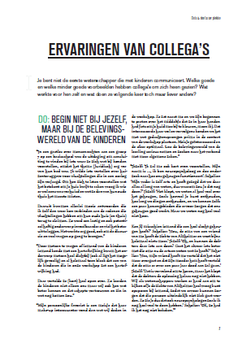

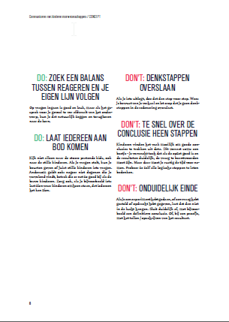
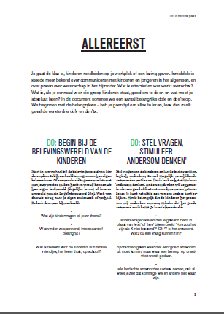
Notes:
meta stuff (conf, scientists training)
Other stuff (some more events, citizen science VPRO)

Slide 17
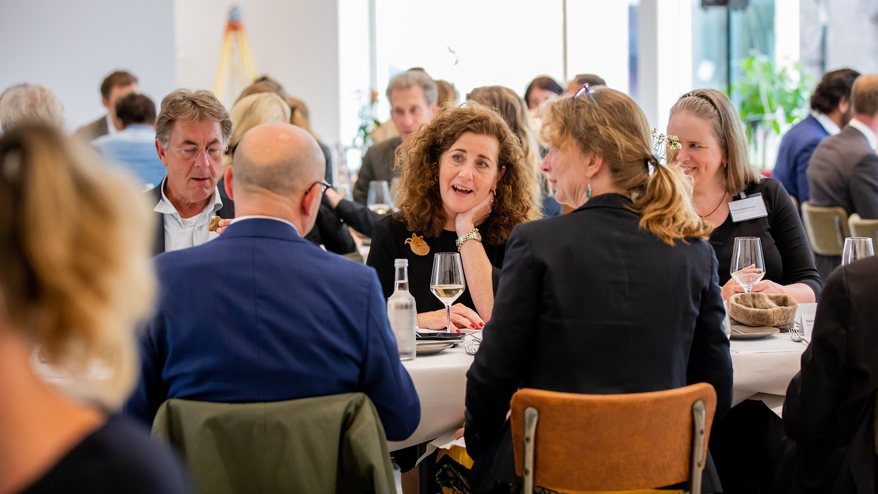

Slide 18
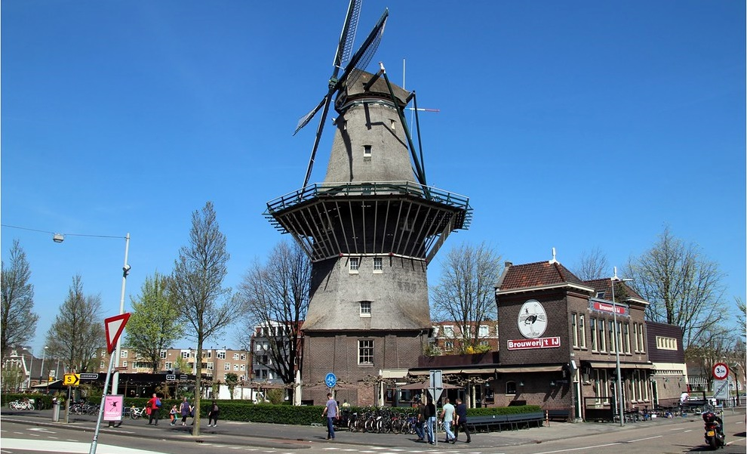

Slide 19
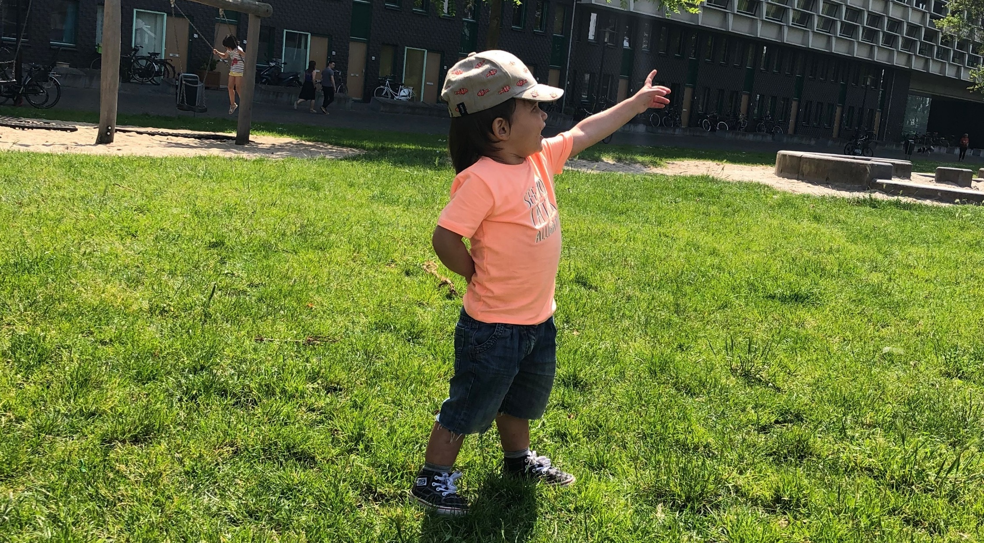

Slide 20
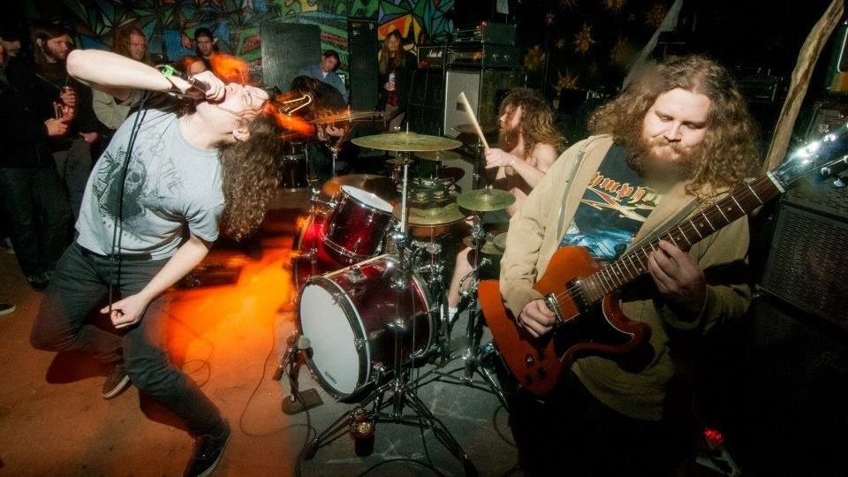

Slide 21
ME
De Praktijk / 200+ sci com projects
Rathenau Institute / sci com policy research
VSC / science centers & museums, community mgmt, advocacy
Amsterdam, 1 child, death metal)
Notes:
a lot of edu materials and some event programming/organisation, but also games etc
RI project in very short

Slide 24
WHY SCI COM?
Why should we* want to do science communication at all?
5 minute discussion in chat
* society, academia, individuals

Slide 25
WHY SCI COM? SOME ANSWERS
Tax money spending transparency
Democracy demands people co-decide
Understanding science gives people autonomy
Public adoption of innovations and new insights
It improves science itself
Generating support for science (funding)
Etc.
Notes:
Some well known reasons

Slide 26
SAME BUT TRANSLATED INTO POSSIBLE POSITIVE IMPACTS
Increased knowledge about what is being done with tax money
More (support for) science based policies
Higher quality of life through more science based decisions in individuals
Faster innovation
Scientific research and applications more attuned to societal demands
More support for the scientific enterprise

Slide 28
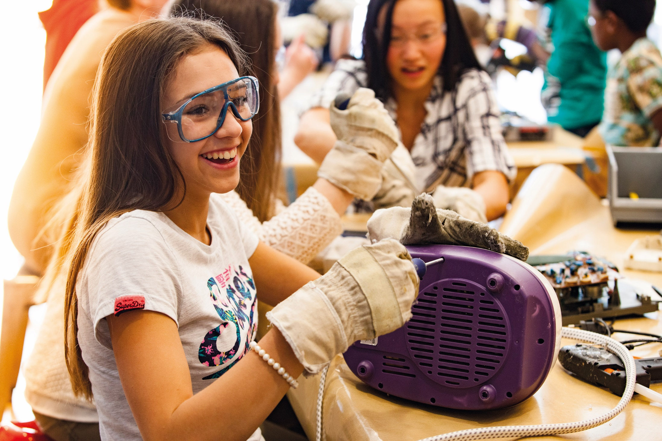

Slide 29
SCI COM TODAY
money and time wasted on bad projects
skewed audience, lost groups
little progress over the years
Notes:
so I see it as my task now to
(lobby the EU)
enlighten key people about sci com as valorization
enlighten key people about quality in sci com, difference with marketing, why it is important (because we should, because it pays of, because we have to)
interesting times for sci com

Slide 30
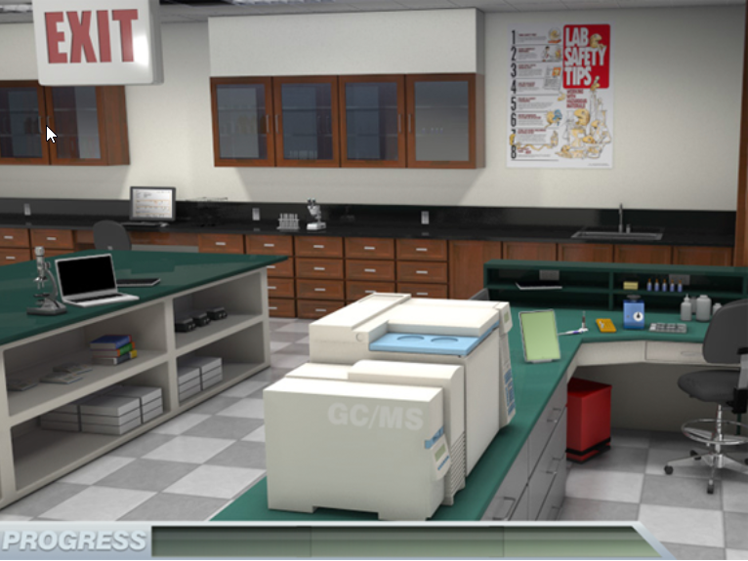

Slide 31
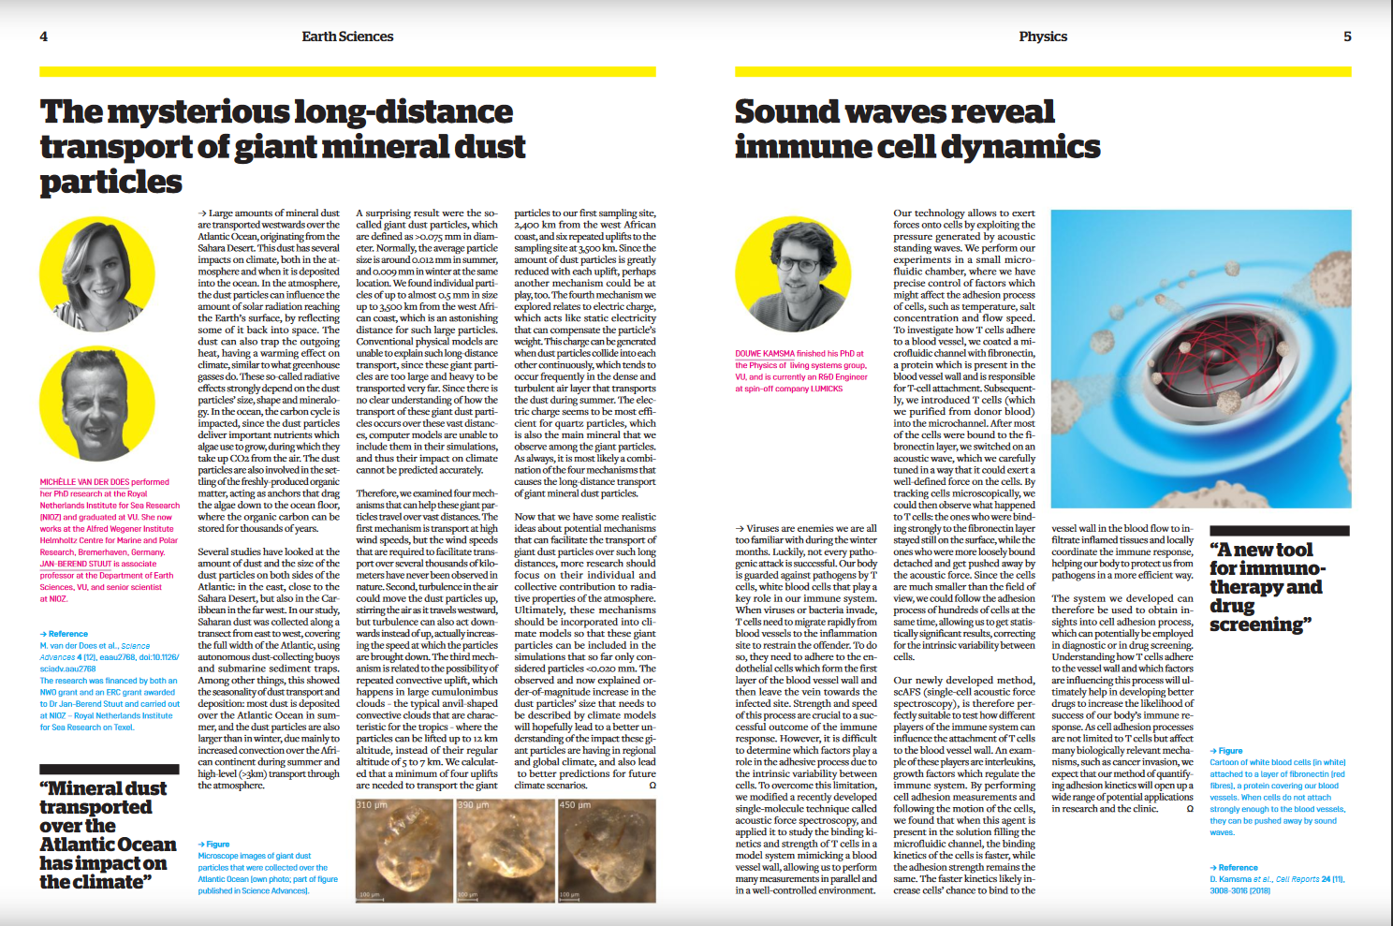

Slide 32
SCI COM TODAY
money and time wasted on low impact projects
skewed audience, lost groups
little progress over the years
growing recognition of importance
motivated professionals and amateurs
Notes:
so I see it as my task now to
(lobby the EU)
enlighten key people about sci com as valorization
enlighten key people about quality in sci com, difference with marketing, why it is important (because we should, because it pays of, because we have to)
interesting times for sci com

Slide 33
HOW DO WE IMPROVE IMPACT?
Break out until...
Discussion guided by 4 questions
System analysis, theory of change
Suggestions for interventions

Slide 34
QUESTIONS
Who does / should do sci com?
What motivates them to do so?
How could we stimulate and support individuals to improve their impact?
How could we make the population improve?

Slide 35
BREAK

Slide 36
HOW DO WE IMPROVE IMPACT?
Analysis
Theory of change
Actions and interventions

Slide 37
MY ANALYSIS
Scientists are main determinant
Sci com is a hobby, not work
No career path for scientists
Little recognition and reward in academia
No incentive or time for improvement

Slide 38
MY THEORY OF CHANGE
allocate funds
funding with conditions
evaluation and knowledge sharing
distinguish high from low quality
diverse careers
funding with conditions
more impact
good sci com
Notes:
stick to the main aspects
make sure all group members know what it is

Slide 39
MY INTERVENTIONS
Distinguish high from low quality
If high quality, recognize and reward as work
Continuously evaluate, innovate, share lessons
Stimulate ongoing conversation about impact
Connect stakeholders
Notes:
Dit is key. Alle expertise is er, toch worden slechte projecten gedaan. Want mismatch beleid/werkvloer. Prikkels zijn er alleen voor publicaties.
Maar: NIET ALLE wtsch hoeven dit te doen. Systeem moet leveren.
Goed en gericht op impact. Uit eigen motivatie, maar gesteund, erkend, beloond door systeem.
Kennis delen. Begeleiden. Dat doen wij dan als veld. Maar dan moet het wtsch systeem wel gaan luisteren.

Slide 41
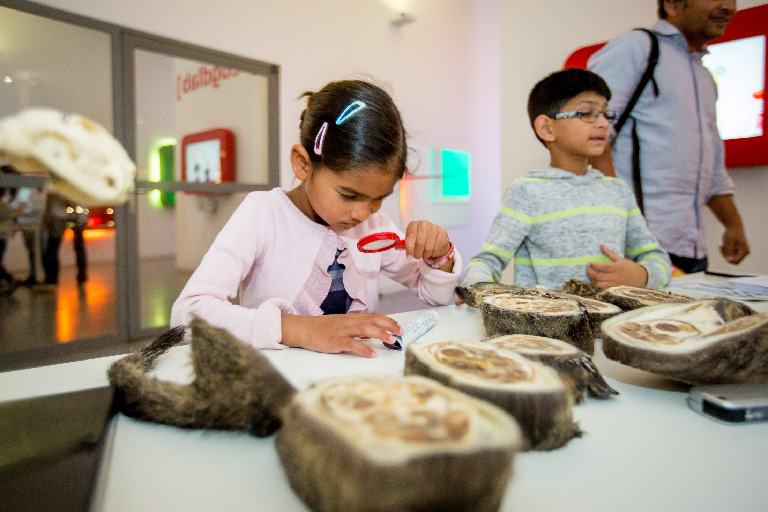

Slide 42
QUALITY CRITERIA
Rathenau Institute 2016-2017
From literature and conversations
Technical vs. normative criteria, in rubrics
Initially made for judging project proposals
But the road is the destination
Notes:
General lessons: it is about PROJECT quality
And about brutal honesty and evaluation
It is used for all kinds of things

Slide 43
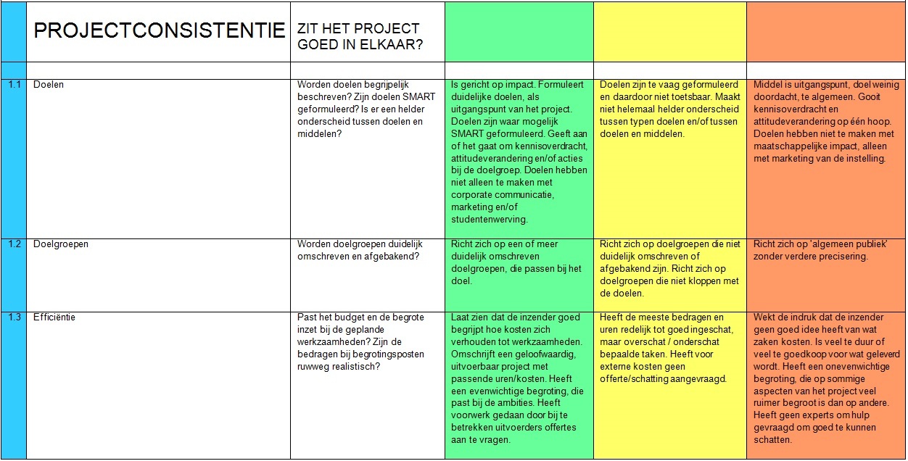
Notes:
Made from literature and input/conversations
inside the instrument
Rubrics table with 15 criteria
technical quality
also normative criteria: impacts we value extra. like diversity in target groups: to create a reward for doing harder work with fewer people.
Information paragraph per criterium
Example projects with judgement

Slide 44
QUALITY CRITERIA GOLD RULES
Start with goal and target group
Engage target group ASAP
Involve experts early on
Reflect & evaluate early and brutally
Share your lessons
Notes:
Sure, it’s fun, but I’m not satisfied if thats all it is. I want IMPACT

Slide 45
QUALITY CRITERIA CONVERSTAIONS
Sci com is growing in perceived importance systemwide
We need to clearly distinguish system from individual
Formal recognition is needed, but also informal culture change
There is a gap between impact people and sci com people in organisations
Notes:
And, from the field: experts agree on the instrument, i.e. there is something like universal quality in sci com and this is in the right direction

Slide 46
WHERE ARE WE NOW IN NL
New €1M / yr funding call for sci com through research council NWO
Criteria geared towards impact
First round deadline = Sept 22

Slide 47
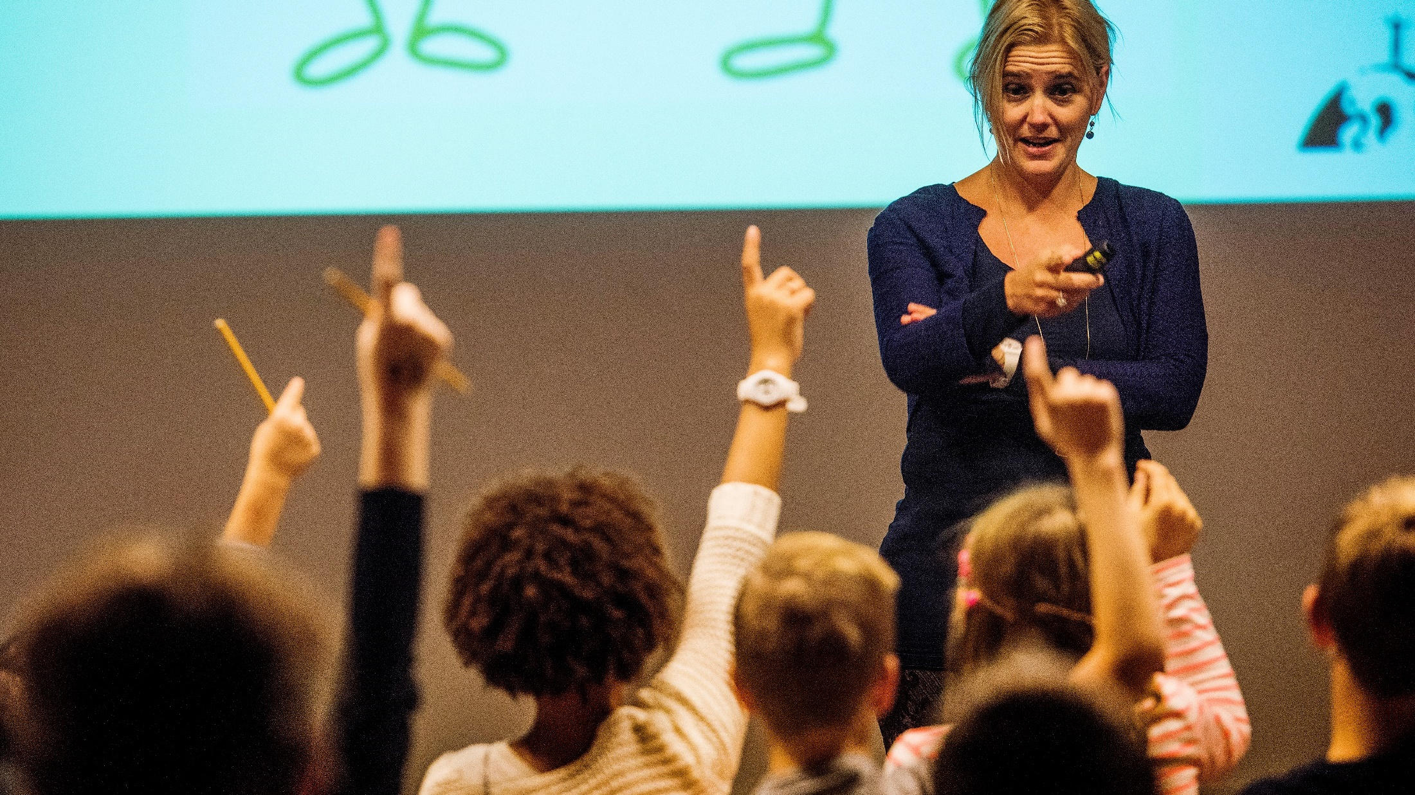

Slide 50
OBSTACLES
Break out until...
Obstacles in your situation
Possible actions to overcome them
Take home message

Slide 51
ACTIONS AND MESSAGES
Please share in chat
1 action
1 take home message for the group

Slide 53
“Just as the public must be educated on scientific topics, so must the scientific community be educated on public attitudes and opinions.”
Chris Mooney (2010) – Do Scientists Understand the Public?
Notes:
How to make your idea a reality? It’s not solely about the quality of your idea, the best ideas don’t get realized automatically.
Money = means, not goal.
For you, but also others.
Free time = sure, but limited. And it is hard to do necessary but unfun stuff in free time.

Slide 54
ASK ME MORE
alex@vsc-netwerk.nl
@alexverkade
LinkedIn
06 4748 6252
www.vsc-netwerk.nl
@sciencemuseums

Slide 55
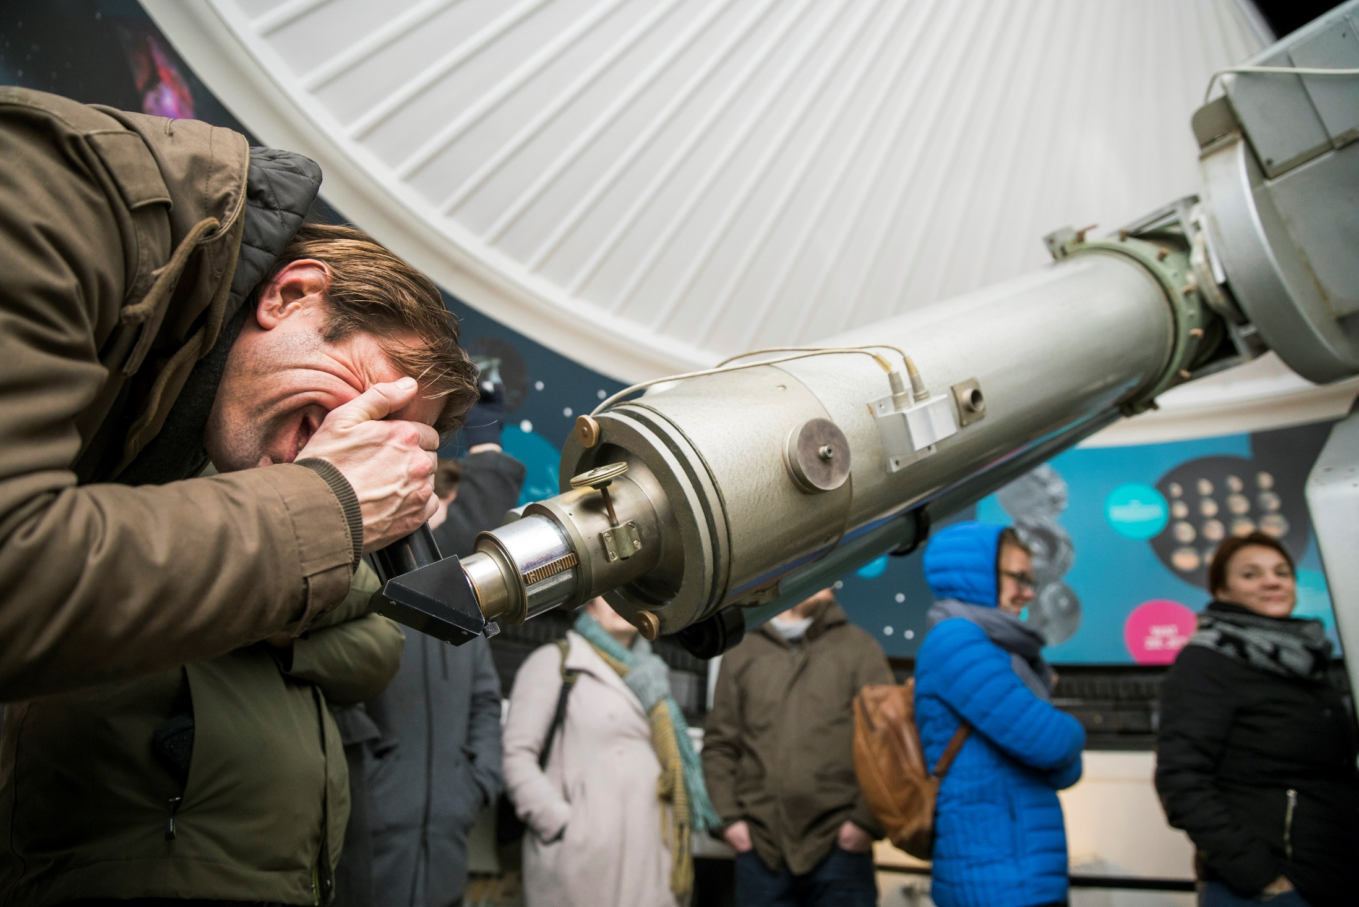

Slide 56



